Slide 1



February 2026
PULSE PLAYBOOK
Q2 2026 PROPOSAL

Slide 2
PurePlay Media Plan
 | Tier 1 - Amplify ($400K) Premium 4-Screen Video | Tier 2 - Foundation ($200K) Premium CTV
CPM | $28 Premium - Ultra, Niche & Core $18.50 OLV Retargeting | $28 Premium - Ultra, Niche & Core
Screens | CTV, Mobile, Desktop, Tablet | CTV Only
Targeting | PurePlay Premium Audience Segments | PurePlay Premium Audience Segments
Activation | CPV OEEs Premium Awareness Sales Lift | CPV OEEs Premium Awareness Sales Lift
Measurement | PurePlay Pulse: Pre-Campaign. Mid-Campaign, Post-Campaign | PurePlay Pulse: Pre-Campaign. Mid-Campaign, Post-Campaign
Added Value | Cuebiq Foot Traffic Measurement Innovid Ad Serving 2 New Innovid Dynamic High Impact Creative Overlays | Cuebiq Foot Traffic Measurement Innovid Ad Serving

Slide 3
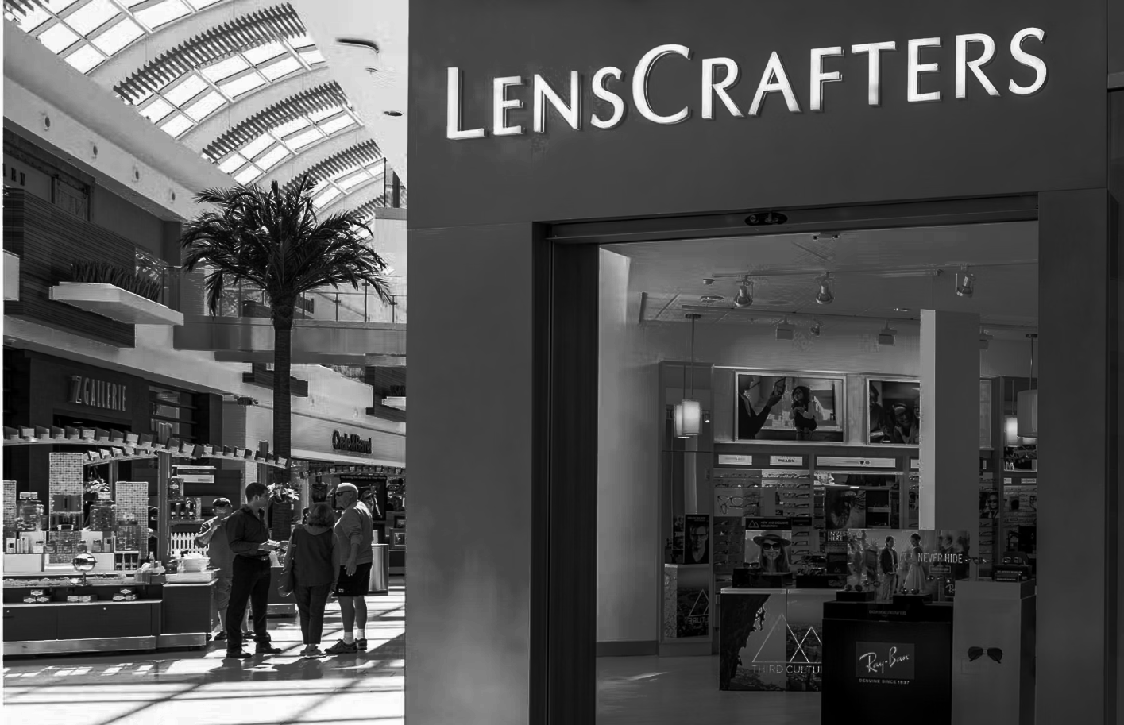
Pulse Playbook
for LensCrafters
Your strategy starts here.
The Pulse Playbook is the only system that unifies creative, audience, and media into a single, outcome-driven plan, directly connected to activation.
It decodes your creative, benchmarks it against the market, and translates those signals into audience and placement decisions designed to drive measurable impact.

Slide 4
Campaign Strategy Recap
CPV-Optimized Precision Every optimization decision is grounded in Cuebiq store visitation data — the same approach that drove SGH to 17% above benchmark at $1.83 CPV.
Audience-First Activation Behavioral and in-market signals identify consumers actively in the vision care purchase cycle. Intent-based, not demo-based.
Premium Inventory Curation Three-tier framework (Ultra-Premium, Core, Niche) with 100% publisher transparency. Every impression is tier-classified and brand-safe.
Dynamic Creative Innovation Innovid overlays personalize every impression with nearest store location, DMA-level messaging, and audience-aligned creative versioning. *$400K Tier Only
PurePlay for Lenscrafters
Four pillars engineered for store visits, not just impressions.

Slide 5

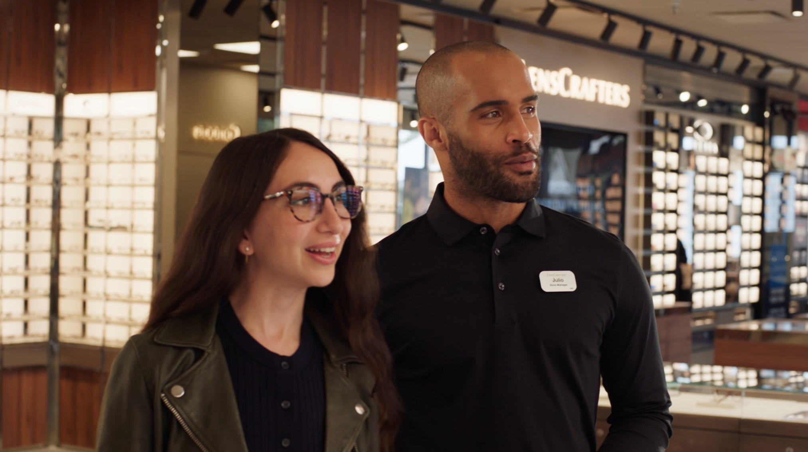
How Your Creative Signals Show Up in Market
Brand-Led Storytelling That Signals Trust & Authority
LensCrafters’ creative centers on “Dedication to Everyday Excellence,” leaning heavily on testimonial and story-driven formats (50% testimonial, 25% story) that elevate people and professionalism over product or price. This signals credibility and long-term care, clearly differentiating LensCrafters from value-first competitors.
A Unified Montage Style That Aligns With High-Impact Moments
Unlike competitors such as Eyemart Express and 1-800 Contacts — where 75–100% of assets include CTAs or promotions — LensCrafters’ creative contains 0% promotional or action-driven messaging. This reinforces LensCrafters’ role as a trusted vision care partner rather than a transactional retailer.
Credibility-First Audience Framing Over Lifestyle Momentum
LensCrafters’ protagonist-led creative skews evenly male and female, ages 35–54, signaling experience, stability, and inclusive professionalism. Compared to lifestyle- or sports-led competitors that emphasize momentum and energy, LensCrafters prioritizes credibility over excitement — reinforcing its role as a trusted authority.

Slide 6



Targeting Where It Matters Most
Turning broad reach into measurable performance through audience precision.
Complete Experiencers
Signal
Consumers who prioritize holistic eye health and premium service — valuing trusted providers, quality care, and an end-to-end vision experience.
Strategy
Anchor presence in Ultra-Premium, high-attention environments that reinforce LensCrafters’ role as a trusted care partner, not a transactional retailer.
Layer healthcare, wellness, and in-market vision signals to efficiently reach households already in decision mode, where brand credibility meaningfully influences provider choice.
Smart Fashion Shoppers
Signal
Style-forward, culturally engaged viewers who see eyewear as both function and self-expression. They value design, quality, and brand curation, and consistently show up around premium lifestyle, fashion, and live-event content.
Strategy
Activate within Premium Niche and select Ultra-Premium lifestyle environments where design, craftsmanship, and aspiration already shape the viewing mindset.
Layer fashion affinity, designer interest, and lifestyle signals to reach high-value style shoppers at scale without diluting brand tone.
Pragmatic Value Buyers
Signal
Outcome-driven households seeking confidence, affordability, and convenience from a comprehensive eye care provider. They value clarity and access, and respond to brands that simplify decisions without sacrificing credibility.
Strategy
Scale efficiently across Premium Core environments, layering value-oriented, insurance-aligned, and in-market vision signals to drive cost-effective reach while preserving a premium brand frame.

Slide 7


Validated Within the EssilorLuxottica Portfolio
SUNGLASS HUT CASE STUDY
Foot Traffic - Measured by Cuebiq
Before PurePlay Optimization
Sunglass Hut’s CTV plan was misallocated across markets and weighed too heavily toward low-attention publishers that did not match the brand’s premium positioning or their affluent luxury-fashion shopper.
After PurePlay Optimization
<$3 Current cost per visit, already below benchmark and expected to drop significantly after conversion window closes.
1.13% Visitation rate - signaling stronger in-store engagement from higher-intent fashion shoppers

Slide 8








PurePlay Activation Solution
LensCrafters Inventory Mix
Informed by Pulse Platform Intelligence
Audience Precision
LensCrafters’ creative speaks to three distinct audiences. PurePlay separates Complete Experiencers, Smart Fashion Shoppers, and Pragmatic Buyers in real time—directing each creative spot into CTV environments aligned with trust, style, or value mindset to maximize impact.
Creative Signal Activation
LensCrafters’ testimonial-led creative signals credibility and life excellence. PurePlay aligns those signals with high-attention, premium CTV placements—amplifying memorability and reinforcing LensCrafters’ authority without relying on urgency or promotions.
Market Calibration
PurePlay calibrates media weight by DMA to reflect store density, demand, and competition—reinforcing LensCrafters in priority markets while efficiently reallocating spend to winnable regions to drive incremental foot traffic.
Inclusion/Exclusion Lists Supported!
100% Transparency
Guaranteed Delivery Toward Ultra-Premium Publishers

Slide 9
Designed for Coexistence
A controlled, measurable test that complements the existing Trade Desk workflow.
STRUCTURE & GUARDRAILS
Defined flight (4/5–7/5), budget ($200K), KPIs (CPV via Cuebiq), and inventory — all confirmed upfront. PurePlay runs as complementary activation, not a replacement.
SUPPRESSION & ALIGNMENT
Bi-directional audience suppression pixels eliminate household duplication. Three publisher alignment options: mutual ownership, blacklist exchange, or full transparency.
MEASUREMENT DIFFERENTIATION
PurePlay layers Cuebiq visitation data with creative intelligence and competitive SOV to influence bid logic and creative weighting — the approach that drove SGH's 17% beat.
SELF-SERVICE ROADMAP
Host Enrichment integrations with OpenX and Magnite connect PurePlay intelligence at the SSP curation layer within TTD. Target: late 2H 2026. Managed service is the test; self-service is the endgame.

Slide 10
PurePlay x LensCrafters 2026
Campaign Details
Flight | April 5th-July 5th, 2026
Screens | CTV Only CTV + OLV
Primary KPI Secondary KPI | Cost Per Store Visit OEEs
Geo | National with DMA-level optimization
Budget | $200K $400K
Overview
With PurePlay’s Pulse Platform and Measurement Suite, PurePlay will activate LensCrafters across Niche, Core, and Ultra-Premium CTV inventory, prioritizing high-intent audiences while navigating a competitive landscape led by value-first, transactional providers. Our approach filters out low-intent reach, focuses investment during moments of elevated demand, and activates around audience readiness rather than broad exposure. The result is stronger in-market presence, clearer performance signals, and measurable in-store foot traffic lift — all while maintaining efficiency within a highly competitive vision category.
Audiences
Complete Experiencers
Smart Fashion Shoppers
Pragmatic Value Buyers
In-Market Vision Care Seekers
Inventory
Ultra-Premium
Premium Core
Premium Niche
PurePilot Activation Solution
Premium CTV Only
Reach, Whitespace, & Viewership
PurePlay Pulse Measurement Suite
Cuebiq Foot Traffic Measurement
Seasonal & Market-Based Heavy Ups

Slide 11

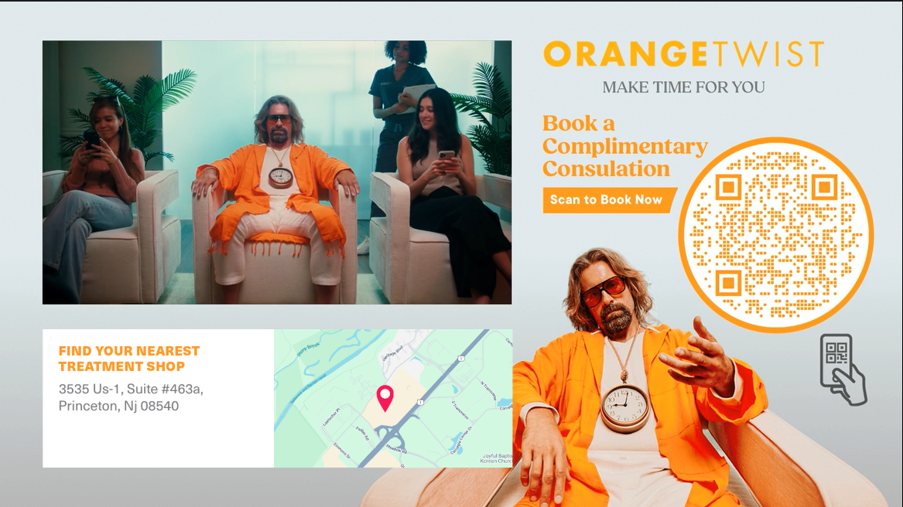
Dynamic Moment Creatives
Ultra, Core, and Niche create a complete premium strategy: engineered to maximize in-store visits & sales momentum.
Shoppable Branded Canvas
Pre-roll video is scaled down to accommodate a branded skin featuring additional branding and/or:
Dynamic elements can further personalize the content
Dynamic Store Locator
A Canvas layout that presents the viewer with the nearest brick & mortar location based on the viewer’s IP address. This can include an optional map of the area. Add product customization and/or a QR Code to make it a shoppable experience.

Slide 12
Premium At Every Level
Ultra, Core, and Niche work together to rebalance distribution, defend leadership, and unlock incremental share of voice across the CTV environments where the vision category is actively competing.
Ultra-Premium
High-attention, long-form environments that reinforce LensCrafters’ Everyday Excellence and build on authority, trust, prestige. Where LC's brand-led creative performs at its highest potential.
Sample Inventory List
Hulu Drama, Documentary, Lifestyle, Travel
HBO Max Docu-series, Prestige Drama, Real-World Storytelling
Disney+ Adult-skewing content only, no kids adjacency
Paramount+ Scripted series, long-form originals
Fubo Selective sports adjacency, pre-game and shoulder content
Premium Niche
Discovery and passion-point audiences with high engagement and lower competitive clutter.
Sample Inventory List
History Channel Craftsmanship, expertise, long-form storytelling
PBS / PBS Living Credibility, trust, family decision-makers
MotorTrend TV Performance, design, form + function
The CW Select adult-skewing content only
The Outdoor Channel Lifestyle, recreation, family orientation
Premium Core
Always-on reach, SOV battleground. Frequency builds and category dominance established through vertical curation.
Sample Inventory List
Roku Channel Lifestyle, Home, Documentary
Tubi Curated verticals only
Pluto TV Genre-controlled placements
Amazon Fire TV Select channels and content hubs
Discovery+ Lifestyle, home, and factual content

Slide 13
PurePlay x Cuebiq Partnership
PurePlay uses Cuebiq’s verified foot traffic data as a live feedback signal — not just a measurement tool.
By layering store visitation data with multimodal creative intelligence and competitive share-of-voice, PurePlay dynamically influences bid logic and creative weighting in real time. The result is incremental CPV efficiency that standard measurement integrations alone cannot deliver.
How PurePlay Uses It
Signal → Action Verified foot traffic data enters PurePlay’s system as a live optimization input — not a post-campaign report. Every bid and creative decision is anchored to real in-store behavior.
17% | above foot traffic benchmarks
Sunglass Hut Proof Point Achieved by applying Cuebiq visitation feedback to dynamically adjust creative weighting and bid logic — not from Cuebiq measurement alone. The signal told us what worked. PurePlay acted on it in real time.
925 | US Store Locations
Geo-Intelligent Spend PurePlay’s Pulse AI layers store proximity into both creative and bid strategy — concentrating spend where LensCrafters can convert intent into a real in-store visit.
The Layering Advantage
Creative Intelligence Loop As visitation patterns shift, PurePlay recalibrates creative weighting in real time — surfacing the formats and messages driving the highest-quality store visits at the lowest CPV.

Slide 14

Pureplay x Cuebiq
Partnership
Cuebiq
Device-level foot traffic attribution that goes beyond measurement. PurePlay feeds Cuebiq visitation signals back into the optimization engine – dynamically adjusting bids and creative weighting to drive incremental CPV efficiency.
Cuebiq's foot traffic and purchase intelligence becomes a live optimization signal — dynamically adjusting bids and creative weighting to drive incremental CPV efficiency.
Affinity via Cuebiq
Purchase-based intelligence. Transaction data enriches audience construction and validates sales lift—connecting media exposure to what actually happens at the register.

Slide 15
Included Added Value
Expanded measurement, intelligence, and optimization — on PurePlay
$400K | $200K
✔ | ✔
✔ | ✔
✔ | ✔
✔ | ✔
✔
✔ | ✔
✔
✔ | ✔
Cuebiq Foot Traffic Measurement
Full-flight attribution + optimization
3× Pulse Playbook Outputs
Pre-Flight, Mid-Flight, Post-Flight intelligence
$400
Publisher-Level Transparency
Every impression publisher-identified and tier-classified
Suppression Pixel Deployment
Bi-directional deduplication with Starcom/TTD
Net Lift Analysis Framework
Four-cell Cuebiq framework isolating incremental contribution
Competitive SOV Intelligence
Category-level share-of-voice monitoring throughout flight
Dynamic Creative Overlays
Innovid store locator + DMA messaging (subject to confirmation)
OEE Tracking Integration
DCM/Innovid pixel on LensCrafters OEE booking page

Slide 16
Committed Cadence, Actionable Intelligence
MAR 18
APR 28
MAY 26
JUL 14
Pre-Flight
Pulse
Mid-Flight
Pulse #1
Mid-Flight
Pulse #2
Post-Flight
+ Cuebiq Final
Competitive landscape, creative intel, audience strategy, GeoPulse market allocation, suppression QA
Month 1 pacing, early Cuebiq signals, publisher performance, optimization actions taken
Cumulative performance, audience-level CPV, DMA reallocation recs for June peak
Full attribution, net lift analysis, publisher CPV rankings, renewal recommendations
PATH TO LAUNCH
01
Finalize Assets & Targeting
02
Confirm Tech & Media Setup
03
Launch
March 1–18
March 18–28
April 5
Creative approved, audiences confirmed, suppression lists exchanged, publisher alignment agreed
Cuebiq pixels tested, suppression QA'd, inventory locked, brand safety verified, Pre-Flight Pulse delivered
Campaign live, reporting begins, first optimization cycle within 48 hours, Week 1 suppression validation

